Slide 1

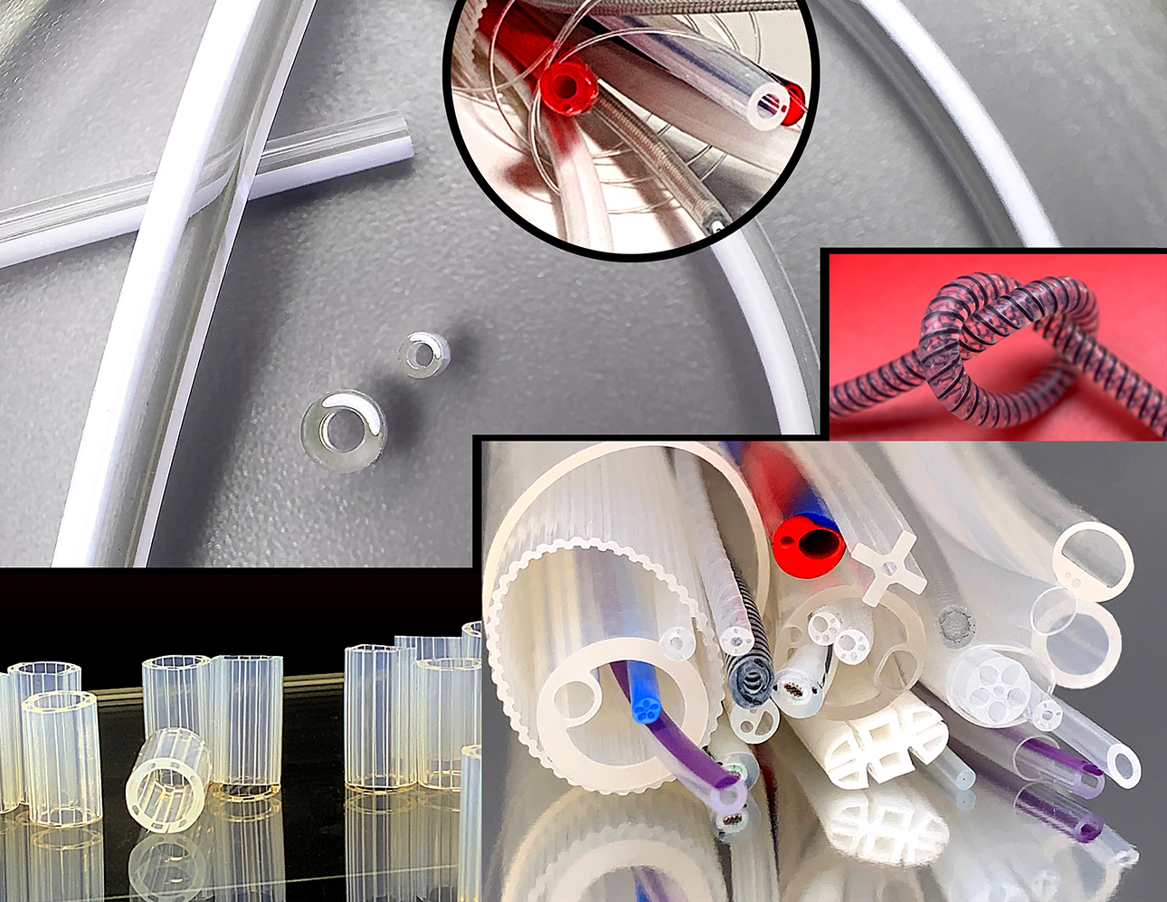
OUR NAME IS WHAT WE DO
We Focus Exclusively
on Providing the Highest Quality Medical Grade Silicone Extrusion
ESTABLISHING PROPER VALIDATION
OF EXTRUED SILICONE TUBING
Bring your project from the process development phase of manufacturing to a fully validated one.

Slide 2

IQ/OQ/PQ
THE PROCESS
Medical device manufacturers understand that contract manufacturers are experts in their manufacturing discipline. That said, as medical device OEMs respond to the current requirements described in the European Medical Device Regulation (EU MDR) or by the Food and Drug Administration (FDA), the topic of process validation is more and more common. Most OEMs simply don’t have a validation plan for a contract manufacturer to follow. While engineers are fully aware that it’s a requirement for releasing their product in the market, many simply want to “check the box” that this has been completed. This article presents a program that moves projects from the process development phase of manufacturing to a fully validated process.1, 2
Prior to jumping into a validation discussion, it makes sense to address the difference between verification and validation. Verification is typically performed while a product or process is being developed. It is a means by which to determine whether a product (or process) meets the dimensional or visual requirements set forth by the product specification. FDA 21 CFR part 820.75(a) stipulates that if process results cannot be fully verified during routine production by inspection and testing (i.e., in-process dimensional checks), then the process must be validated according to established procedures. That being stated, OEMs want to be certain that when they order a particular component, it arrives in-spec each and every time.

Slide 3
INSTALLATION QUALIFICATION - IQ
As with all projects, there are many moving pieces. Some steps move in parallel while others move in series. The backbone in the development of a validated process are the three Qs, otherwise known as IQ/OQ/PQ. Each step toward the validated process builds on the previous step (see the sidebar “Validation Outline”). The qualification activity begins following a FMEA (failure mode effects analysis).
IQ – INSTALLATION QUALIFICATION. This is the verification that the manufacturing equipment is installed correctly. For example, is the electrical power correct for the input of the machine? The same questions have to be asked about all equipment in the process, including ovens and temperature set points, puller wheels, and their respective speeds. This step is easily overlooked but the list for validating equipment must be complete. The important distinction to be made in this step is that all measurements are performed with calibrated inspection equipment. Examples of calibrated equipment used during this step are digital multimeters and a calibrated stopwatch.
In order to process silicone, required equipment includes scales (analytical balance) to weigh raw materials, two roll mills for raw material preparation, extruders, curing ovens with some means of conveying the extrudate through the ovens, and possibly a postcure oven for normalization. Each piece of equipment needs to have completed its own IQ that must be documented for review. For example, to qualify SiMEDEx’s oven, the technicians placed 12 thermocouples in the oven (four on the top shelf, four on the middle shelf, and four on the bottom shelf) spaced equidistant from one another. The oven was brought up to temperature (392 °F/200 °C) for four hours and showed that the oven held ±5 °F at each location during the duration of the heat soak. Another example would be showing that the extruder screw speed reacts accordingly to the inputs received by the operator. For example, when you power up the extruder and input a screw RPM does the machine react accordingly? This is all documented in a protocol established by the SiMEDEx engineering group, and in some instances, is also reviewed by the customer. Additionally, any preventative maintenance steps must be established in this step when bringing on a piece of equipment online.

Slide 4

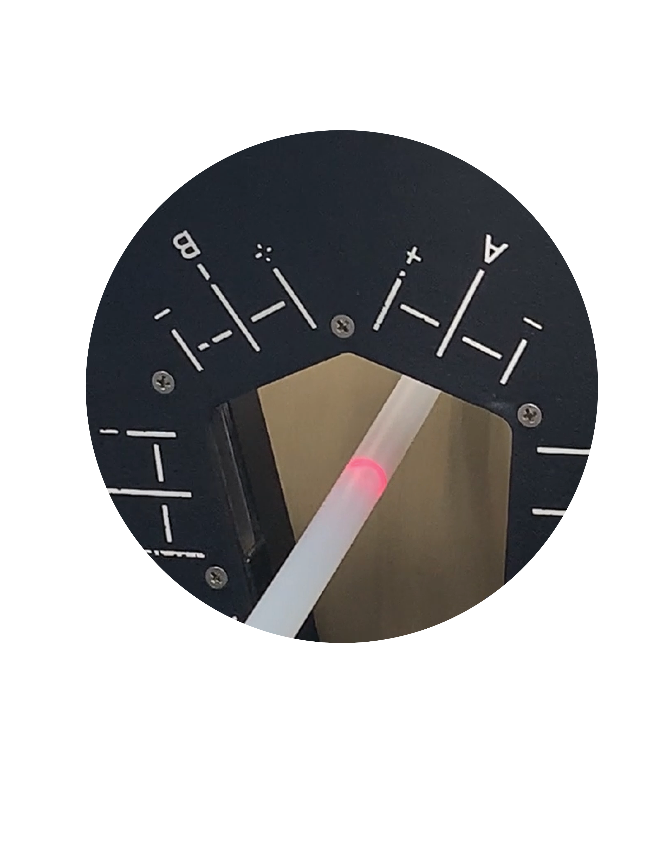

OPERATIONAL QUALIFICATION - OQ
OQ – Operation Qualification. This is the verification that the installed equipment is working properly. It is also in this step of the validation that engineering studies must be performed for process development. Die and mandrel sizes are selected based on historical performance of the raw material specified. Questions to ask include:
How much die swell do we anticipate for this particular raw material?
How much draw down do we anticipate for the processing of a particular raw material?
It is at this point that tooling is modified to ensure a stable manufacturing process?
Once tooling dimensions are determined, it is time to begin a series of engineering studies to establish processing windows (minimums and maximums) for the critical processing variables. Some customers have referred to these processing windows as the worst case for manufacturing product that meets dimensional and visual specifications. For silicone extrusion, those key variables are processing temperature (to ensure proper vulcanization) and line speed.

Slide 5

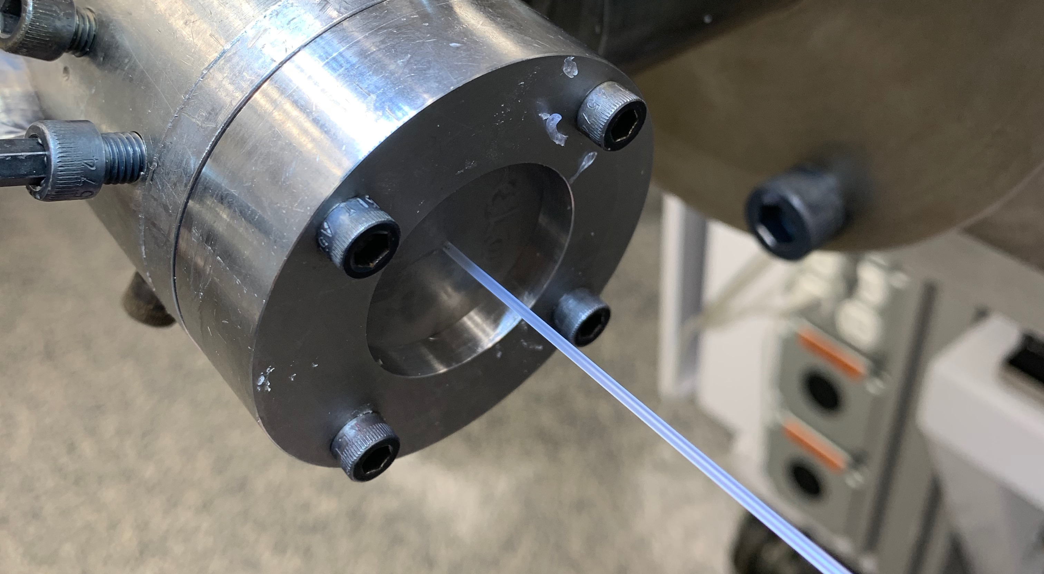
PROCESS QUALIFICATION
PQ – Process Qualification. The process qualification is really where the rubber hits the road (yes, pun intended). Building on the previous engineering runs, these runs are performed at the nominal settings for the process. For example, if the worst case OQ runs showed that product could be manufactured at 25 ft/min and 15 ft/min, a good setting would be 20 ft/min as the feed rate for the process qualification lots. In most cases, it is best to perform a minimum of three different setups with two distinct lots of raw material. This shows repeatability of the process setup while also accounting for lot-to-lot variability.
It is becoming more and more common for manufacturing engineers to look at statistical process control to ensure that a manufacturing process is stable. A minimum CpK value of 1.33 on the critical dimensional attributes illustrates that the process for extruded silicone tubing is in control.

Slide 6

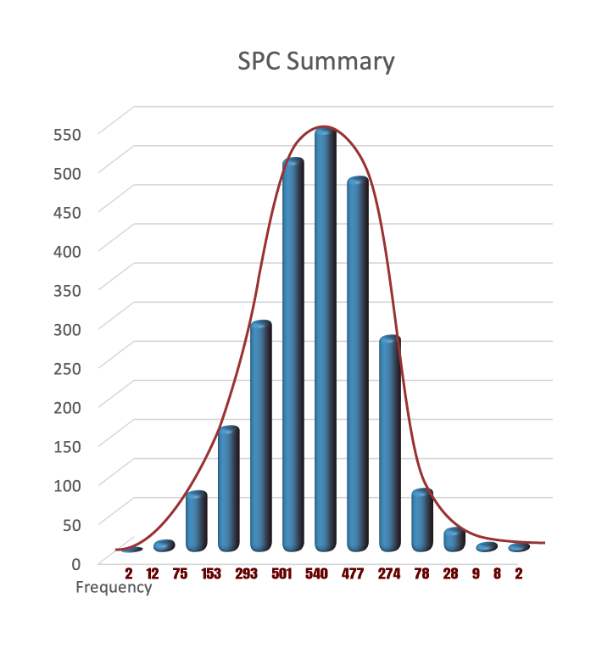
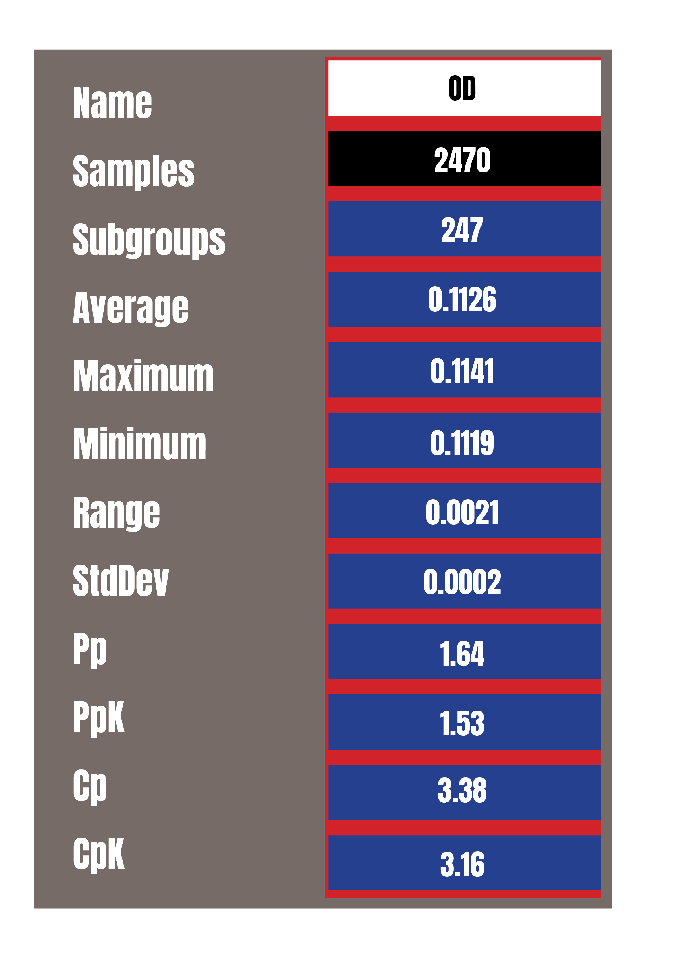
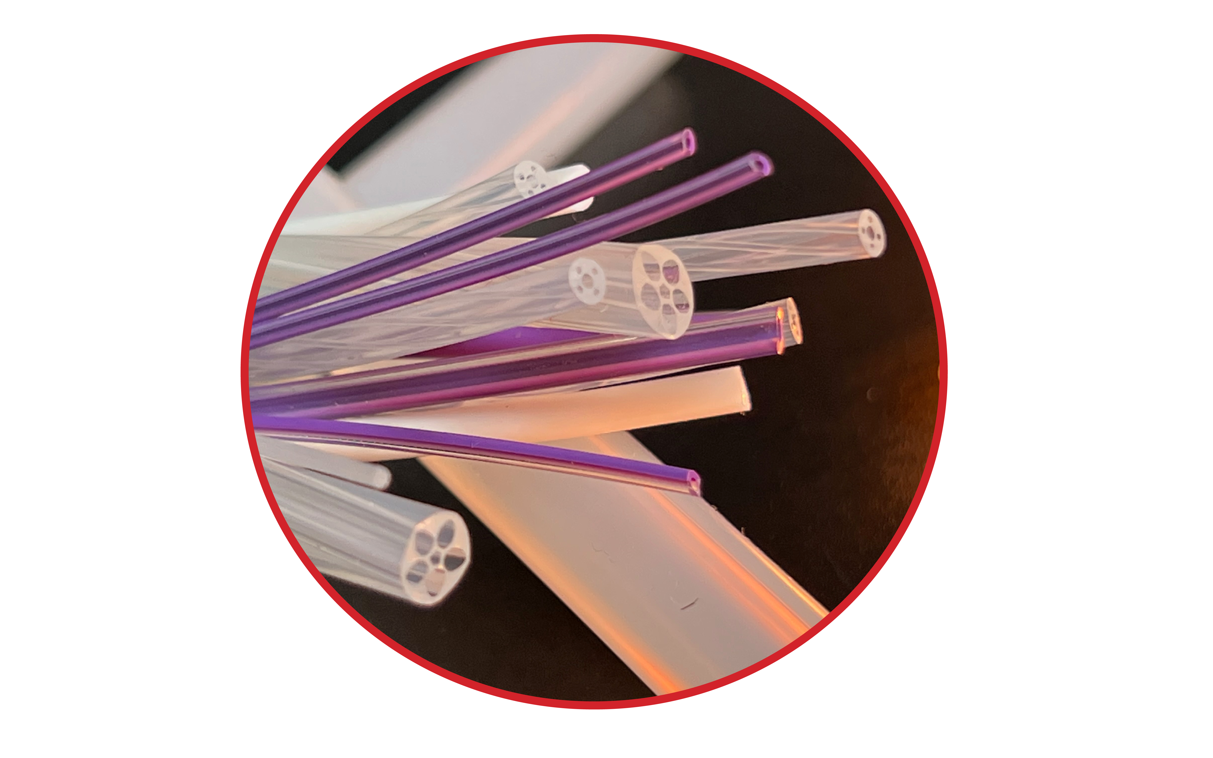
IQ/OQ/PQ
SIGNATURES AND DATA OF EXTRUDED SILICONE TUBING
This statistical work is typically performed on a minimum of 30 samples, and the CpK is calculated from this data set. At SiMEDEx, a report summarizing the findings is presented to the customer showing that the process meets the minimum CpK requirements and is routed with for appropriate signatures.
3020 Propeller Dr., Suite 101, Paso Robles, California 93446 USA. 805-610-6444
Article: www.medicaldesignbriefs.com. 2022 Paul Mazelin, President of SiMEDEx.

